Slide 1
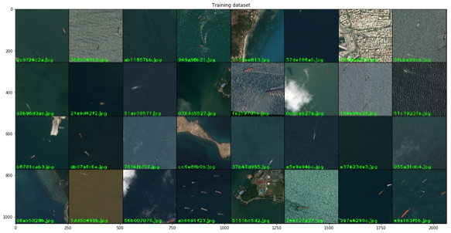
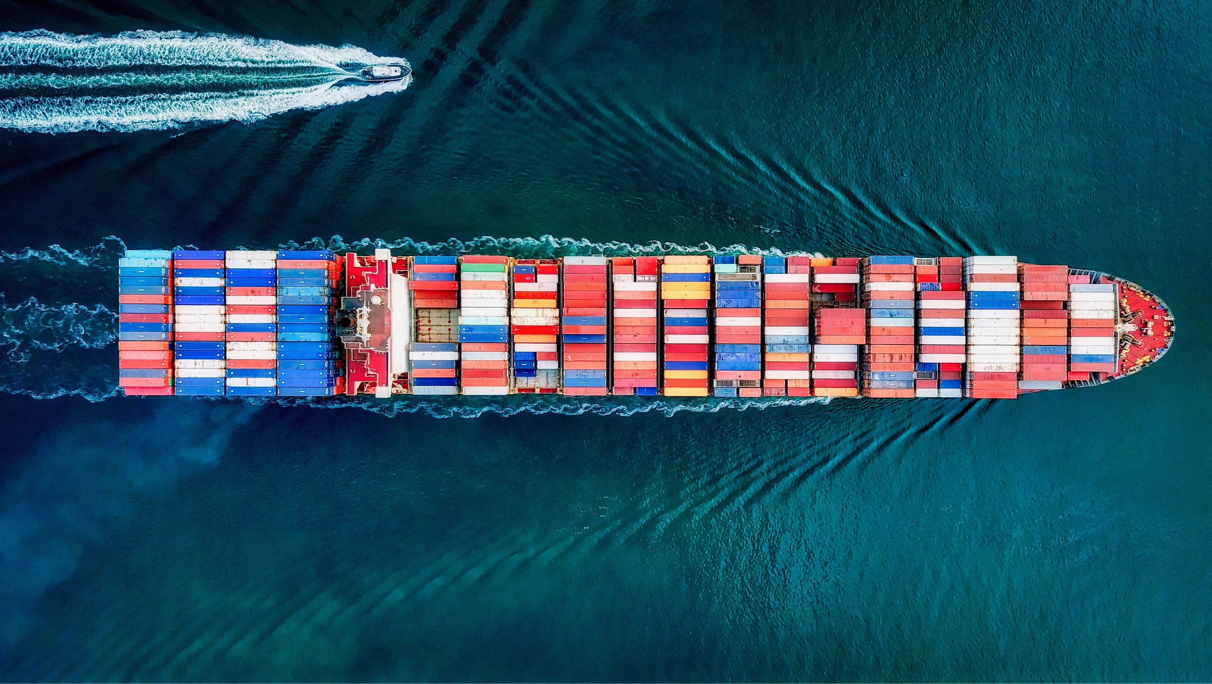
Ship classification & segmentation
Nazih Kalo

Slide 2
Outline
Introduction (Objective, Dataset, Recap Computer Vision)
EDA
Image Classification
Semantic Segmentation
Conclusion
Notes:
The metric sweeps over a range of IoU thresholds, at each point calculating an F2 Score. The threshold values range from 0.5 to 0.95 with a step size of 0.05: (0.5, 0.55, 0.6, 0.65, 0.7, 0.75, 0.8, 0.85, 0.9, 0.95). In other words, at a threshold of 0.5, a predicted object is considered a "hit" if its intersection over union with a ground truth object is greater than 0.5.

Slide 3
Introduction (Objective, Dataset, Recap Computer Vision)

Slide 4
Objective
“Locate ships in images, and put an aligned bounding box segment.”
Notes:
Images may contain no ships, single ship or many ships
Ships can be located in open sea, at docks, marinas, etc.

Slide 5
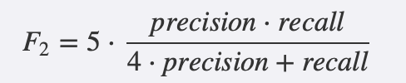
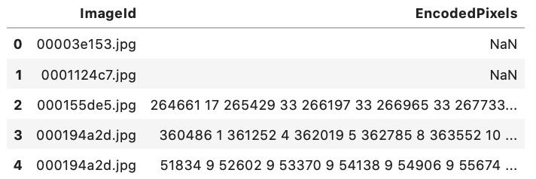
Dataset
Training & Test Sets:
train.zip:
192,556 images
26.4GB
test.zip
15,606 images
2.2 GB
train_ship_segmentations.csv:
Provides the ground truth for the training images
Masks are in run-length encoding format (e.g. '1 3' implies starting at pixel 1 and running a total of 3 pixels (1,2,3))
Evaluation Metric:
F2 Score at different intersection over union (IoU) thresholds
F2 Score is the weighted average of precision and recall
Weights recall higher than precision
Notes:
The metric sweeps over a range of IoU thresholds, at each point calculating an F2 Score. The threshold values range from 0.5 to 0.95 with a step size of 0.05: (0.5, 0.55, 0.6, 0.65, 0.7, 0.75, 0.8, 0.85, 0.9, 0.95). In other words, at a threshold of 0.5, a predicted object is considered a "hit" if its intersection over union with a ground truth object is greater than 0.5.

Slide 6
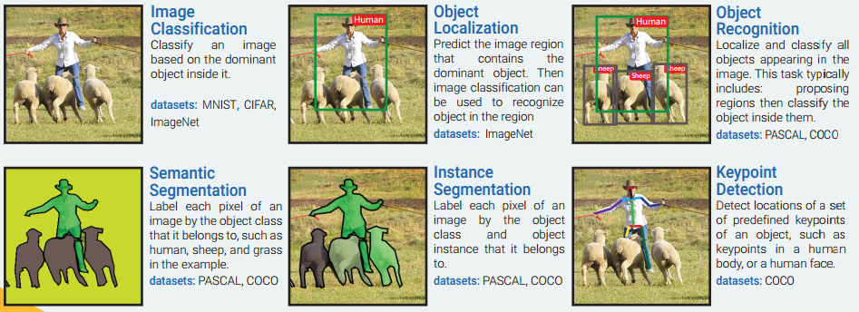
Recap: Computer Vision
Our modeling & analysis will be limited to Image Classification
We will also explain the modeling techniques involved in Semantic Segmentation (since it is the objective of the Kaggle Competition)

Slide 7
Exploratory Data analysis

Slide 8
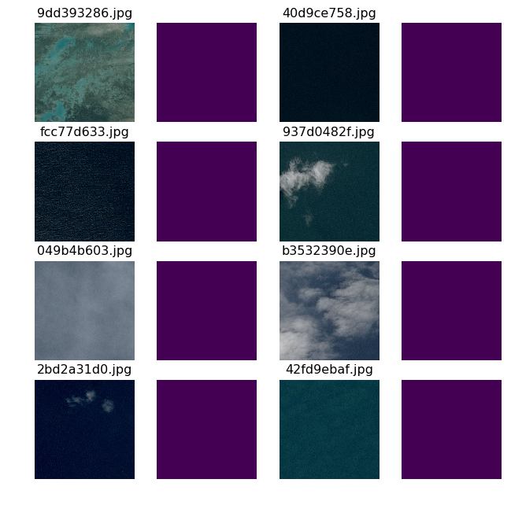
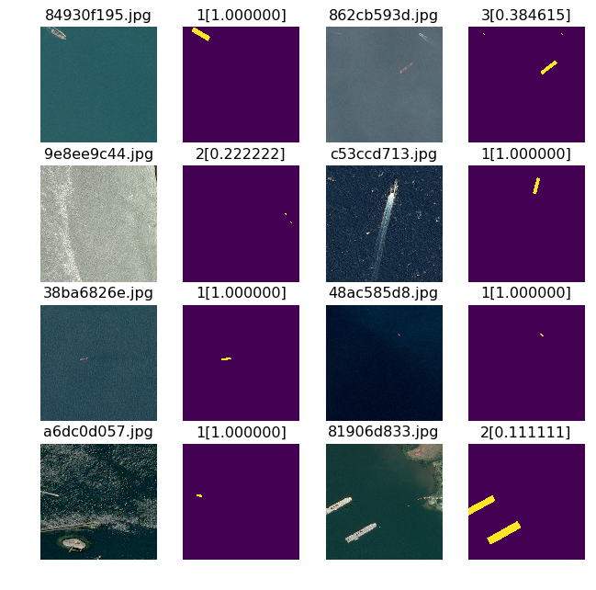
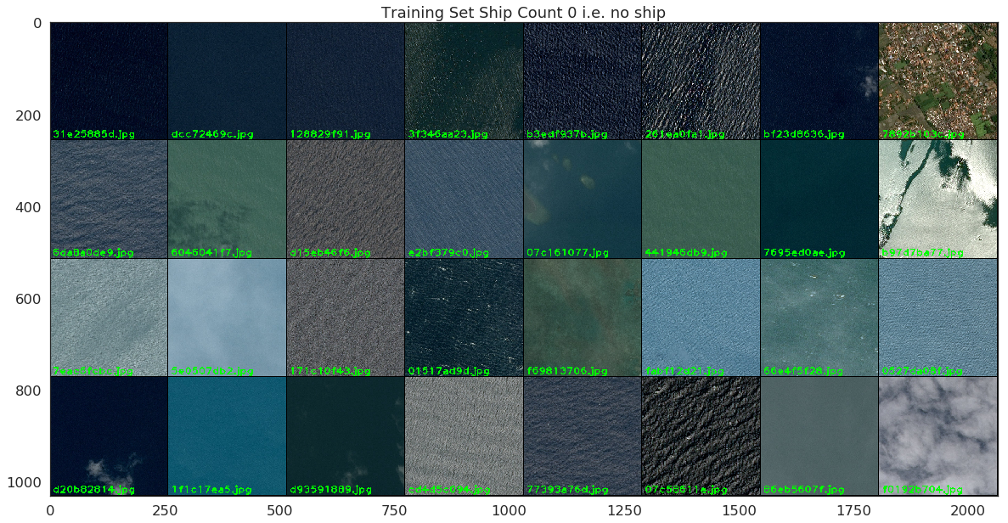
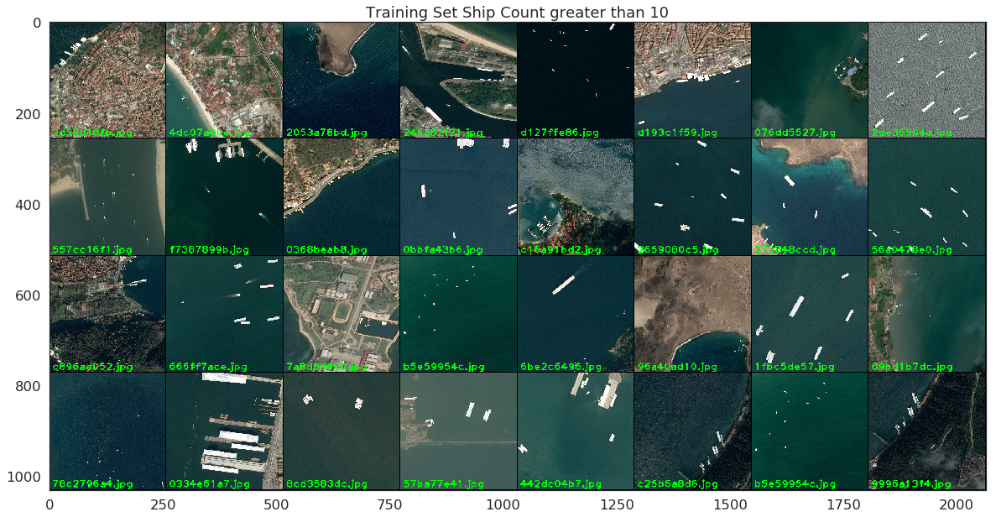
EDA
Images with no ships along with their masks:
Images with ships along with their masks:
Notes:
Short insight what the images actually look like
To the left images without ships, to the right images with ships
A lot of distractions in the images, like clouds, marinas, land for example
To the right, we also see what the ship segmentation should ideally look like – ships should not only be classified, but their location in the image should also be marked exactly → However, we are focusing only on the classification

Slide 9
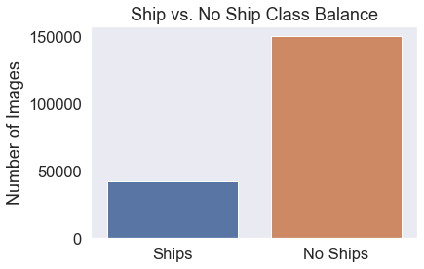
EDA
Ship vs. No Ship:
Dataset is highly imbalanced
~ 3x # of images without ships than with ships
Need to balance!
Distribution of # of ships per image:
Most images that have a ship in it have between 1-4 ships
Some extreme images with 10 or more ships
Notes:
Looking at the distribution of ships vs no ships, we see that the dataset is highly imbalanced, with about three times as many images having no ships in them than images having ships in them → Since this is a classification task, we might need to balance the dataset later on
As for the distribution of ships per image, most of them have 1-4 ships, even though there are a couple of outliers with ten or more ships
For the color distributions code:
https://www.kaggle.com/ezietsman/airbus-eda

Slide 10
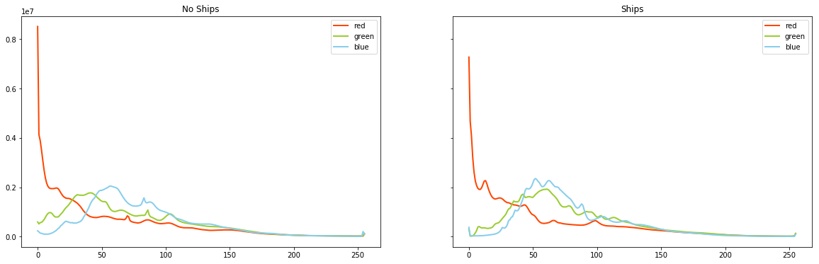
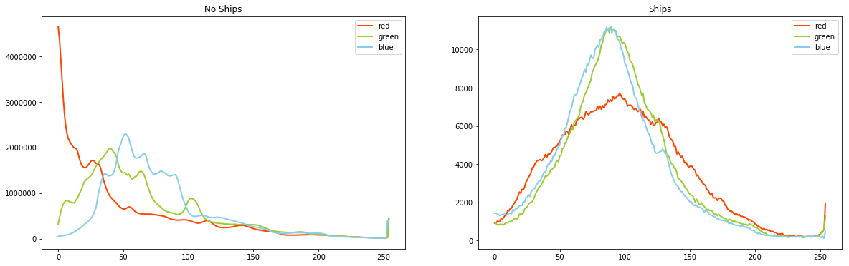
EDA
Look at color distributions between images with ships and those without:
Look at color distributions of areas with no ships and ships themselves:
Notes:
The color distribution does not look very different for the overall ships comparing images with ships to images without ships
However, close up the individual areas do have a very different color distribution → The fact that ships do not affect overall color distribution shows that they take relatively small pixels of the images overall, which makes it harder to detect them
For the color distributions code:
https://www.kaggle.com/ezietsman/airbus-eda

Slide 11
Image Classification

Slide 12
Image Classification
Using transfer learning (CNN) for binary image classification task
Overview:
Rather than trying to segment, we build a model that tries to identify if any boat shows up in the image
We are using transfer learning (‘DenseNet169’)
Going on, the model could be useful as a quick way to screen through a lot of images to see if they are likely to have a boat and if they are then run a more expensive full-resolution model on that sample
Motivation of using CNN:
CNNs are very good feature extractors that learn filters/characteristics (extracting useful attributes from an already trained CNN with its trained weights)
Reduces images to a form which is easier to process, without losing relevant features
Less pre-processing required
Can provide a reasonable baseline result based on which further improvements can be incorporated
Notes:
As mentioned earlier, for this project we are focusing on binary classification – ship no ship – instead of segmentation
Because of limited resources and for the sake of better results, we are focusing on transfer learning, more exactly Densely Connected Convolutional Networks, which I will talk about in more detail in a minute
In terms of the original segmentation problem, this approach could be used as a quick approach to see if an image has a boat or not, and then apply segmentation only to those that have a boat
Why Convolutional Neural Networks?
Filters do not need to be hand-engineered, but CNN will learn filters/characteristics with enough training data
Therefore, also less pre-processing required
Captures the spatial and temporal dependencies in more complex images through the application of relevant filters
Reduces images to a form which is easier to process, without losing relevant features
CNNs:
https://towardsdatascience.com/a-comprehensive-guide-to-convolutional-neural-networks-the-eli5-way-3bd2b1164a53

Slide 13
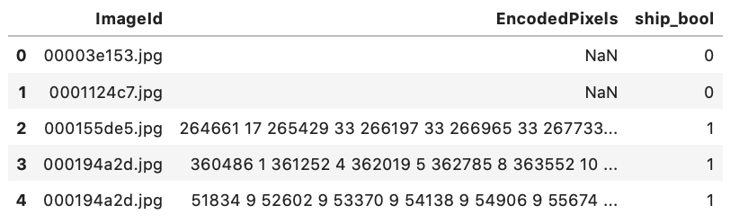
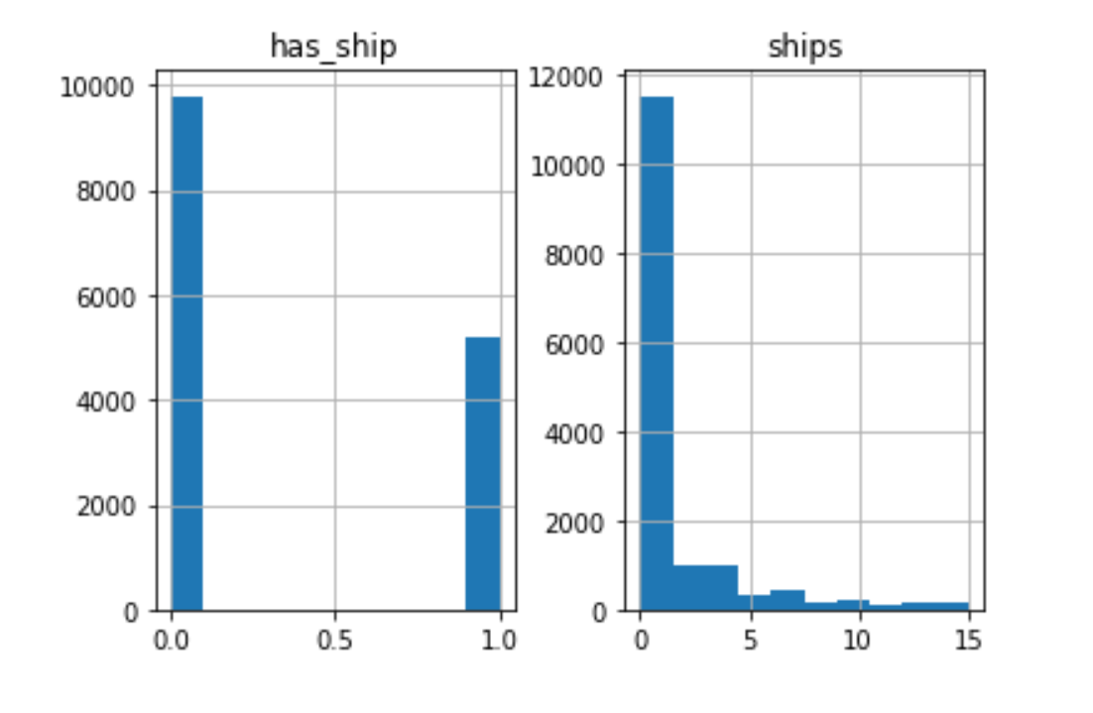
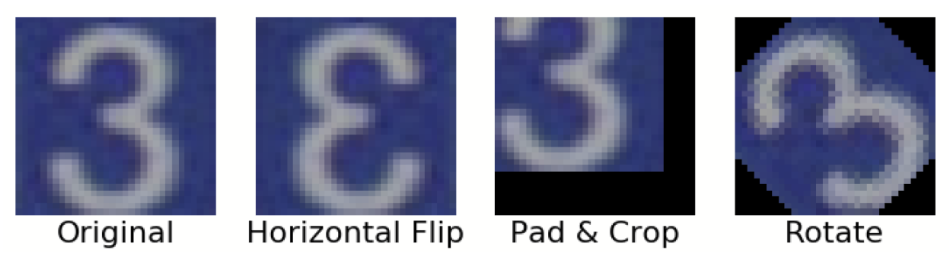
Image Classification
Data Processing & Augmentation
Processing:
Convert ‘EncodedPixels’ column to binary outcome
Balanced by down-sampling dataset to 15,000 obs
Stratified train-test-split (70/30) by ‘ship_bool’
Augmentation:
“Data augmentation is a strategy that enables practitioners to significantly increase the diversity of data available for training models, without actually collecting new data. Data augmentation techniques such as cropping, padding, and horizontal flipping are commonly used to train large neural networks.” [1]
Augmentation techniques used:
Rotation, Shifting, Adjusting Brightness, Zooming, Flipping
Example of common techniques:
Sources:
[1] Ho et al. (2019): https://bair.berkeley.edu/blog/2019/06/07/data_aug/ .
Notes:
Basic processing:
As mentioned before, there is not much pre-processing needed
All we did was creating a new column for the classification task, with one for ship and zero for no ship
We also down-sampled our dataset to 15,000 images for better processing and to somewhat balance the ship vs no ship groups
Then applied stratified train-test split with a ratio of 70 to 30
Augmentation:
We applied some augmentation techniques to make the images more diverse
Used ImageDataGenerator in keras
Applying augmentation techniques makes the model more generalizable
https://towardsdatascience.com/augmentation-for-image-classification-24ffcbc38833

Slide 14
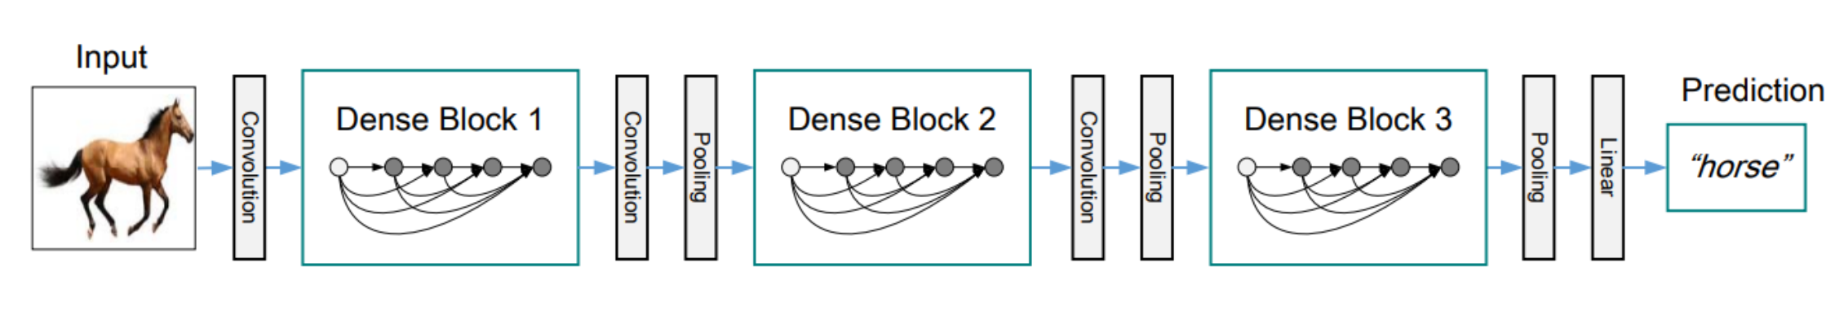
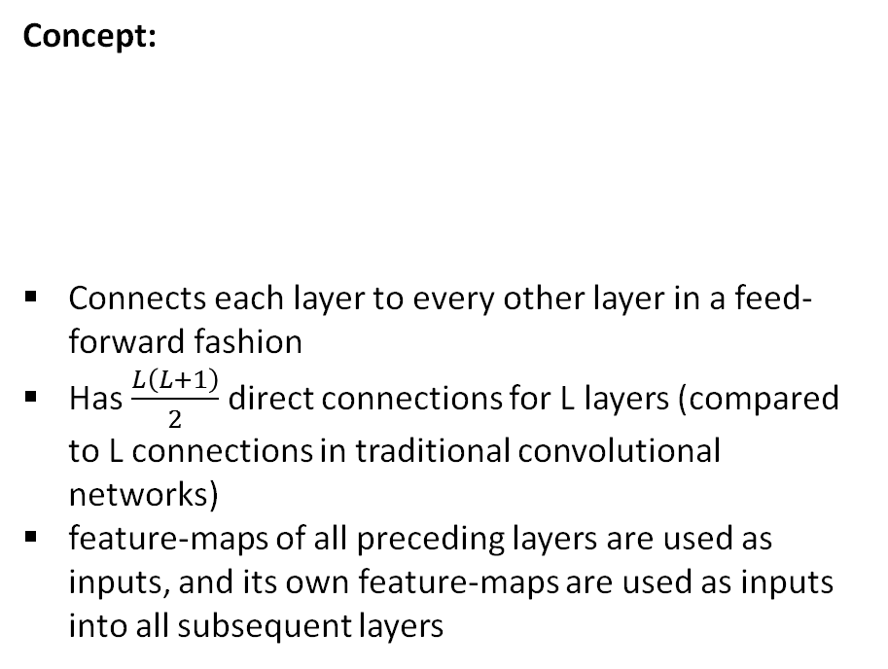
Image Classification
Densely Connected Convolutional Networks [1]
Concept:
Connects each layer to every other layer in a feed-forward fashion
Has $\frac{L\left(L+1\right)}{2}$ direct connections for L layers (compared to L connections in traditional convolutional networks)
feature-maps of all preceding layers are used as inputs, and its own feature-maps are used as inputs into all subsequent layers
Advantages:
Alleviate the vanishing-gradient problem
Strengthen feature propagation
Substantially reduce the number of parameters
More diversified features
Well suited for various computer vision tasks built on convolutional features
Disadvantages:
Requires enormous amount of memory
Sources:
[1] Huang et al., (2016): Densely Connected Convolutional Networks.
Notes:
Jointly invented by Cornell University, Tsinghua University and Facebook AI Research (FAIR) in 2016/2017
In DenseNet, each layer obtains additional inputs from all preceding layers and passes on its own feature-maps to all subsequent layers. Concatenation is used. Each layer is receiving a “collective knowledge” from all preceding layers.
Since each layer receives features from all preceding layers, network can be thinner and compact (e.g., less channels)
For each composition layer, Batch Normalization, ReLu, and 3x3 Convolution are done for all feature maps
Advantages:
Strong Gradient Flow/Alleviates vanishing gradient problem + strengthen feature propagation:
error signal can be easily propagated to earlier layers more directly.
This is a kind of implicit deep supervision as earlier layers can get direct supervision from the final classification layer.
Reduced number of parameters
For each layer, number of parameters in ResNet is directly proportional to Inout×Output (CxC) while Number of parameters in DenseNet is directly proportional to l×k×k.
Output for DenseNet is has less feature maps than for example for ResNet
More diversified features:
Since each layer in DenseNet receive all preceding layers as input, more diversified features and tends to have richer patterns.
Disadvantage:
Requires enormous amount of memory, because it has to store previous layers
https://towardsdatascience.com/review-densenet-image-classification-b6631a8ef803

Slide 15
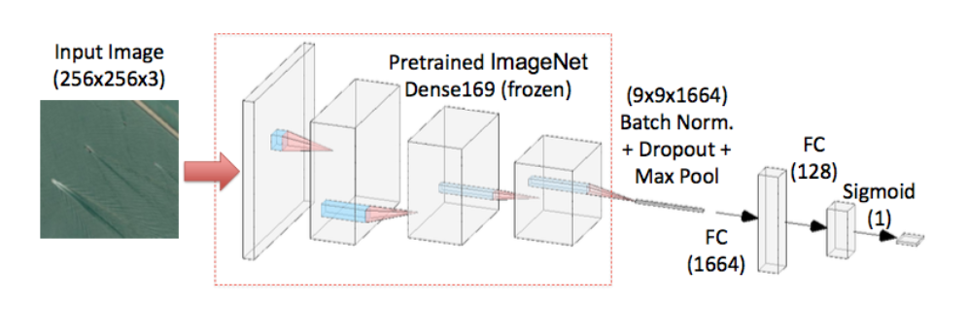
Image Classification
Pre-trained CNN approach [1]
[1]
Epochs: 30
Batch size: 64
Optimizer: Adam
Cross-entropy loss for loss function
Batch Normalization is applied to improve training speed, enable increased learning rate, and reduce covariance shift (important, because ‘DenseNet169’ was not trained on ships)
Dropout to reduce overfitting
Max Pooling to prevent overfitting and reduce computational cost by reducing number of parameters
Decaying learning rate to facilitate model training
Weights of model would not be updated, if the loss of development set did not improve after training an epoch
Sources:
[1] Chen et al., (2018): Traditional vs. Convolutional Neural Network Approach.
Notes:
Cross entropy loss:
Since we are predicting the probability of the image containing a ship, we are using Cross Entropy Loss Function
Measures the performance of a classification model whose output is a probability value between 0 and 1
Increases as the predicted probability diverges from the actual label
A perfect model would have a log loss of 0
Penalizes especially those predictions that are confident and wrong
Hinge etc. are for regression → This is classification!
Batch Normalization:
Normalizes value between 0 and 1
Increases training speed, enables increased learning rate, and reduces covariance shift (makes it more generalizable)
Covariance shift: Change in the distribution of independent variables between train and test set → We saw in EDA part, some images have clouds, land, marians while others don’t → Change of distribution
https://www.analyticsvidhya.com/blog/2017/07/covariate-shift-the-hidden-problem-of-real-world-data-science/
Dropout:
Randomly dropping units (e.g., neurons) and not considering them for forward or backward pass
Neurons can develop co-dependency amongst each other during training which curbs the individual power of each neuron leading to over-fitting of training data
https://medium.com/@amarbudhiraja/https-medium-com-amarbudhiraja-learning-less-to-learn-better-dropout-in-deep-machine-learning-74334da4bfc5
Max Pooling:
Returns maximum value from portion of the image covered by the kernel
MaxPooling also performs de-noising by discarding noisy activations altogether (avgPooling only performs dimensionality reduction) → Therefore, MaxPooling works better
Decreases spatial size of the convolved features → decreses computational power and extracts only dominant features (dimension reduction)
Fully Connected Layers:
Learning a possibly non-linear function → Well suited to add after convolutional layers for classification tasks
Flatten image into column vectors and feed to feed-forward neural network
https://towardsdatascience.com/a-comprehensive-guide-to-convolutional-neural-networks-the-eli5-way-3bd2b1164a53

Slide 16
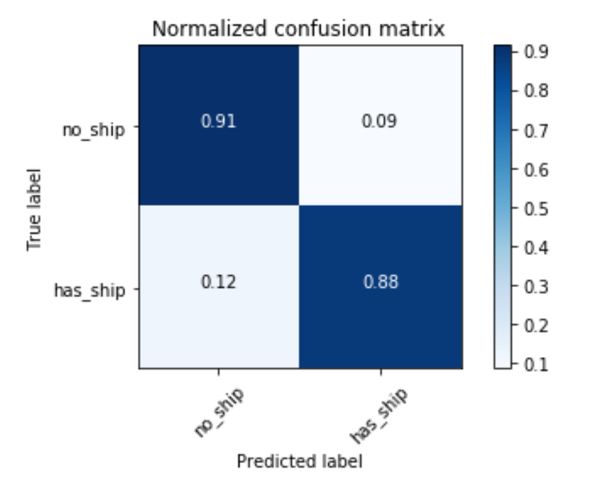
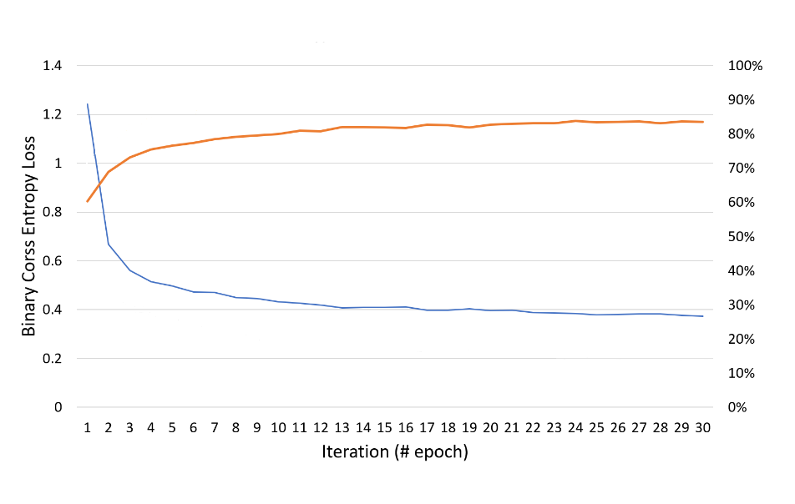
Image Classification
Results
Precision: 0.91
Recall: 0.88
Specificity: 0.92
F2: 0.89
Plotted the training loss curve as well as the training accuracy curve for 30 epoch
Biggest decay in loss within first ~ 3-4 iterations
Accuracy almost saturated after ~ 5-6 iterations

Slide 17
Semantic Segmentation

Slide 18
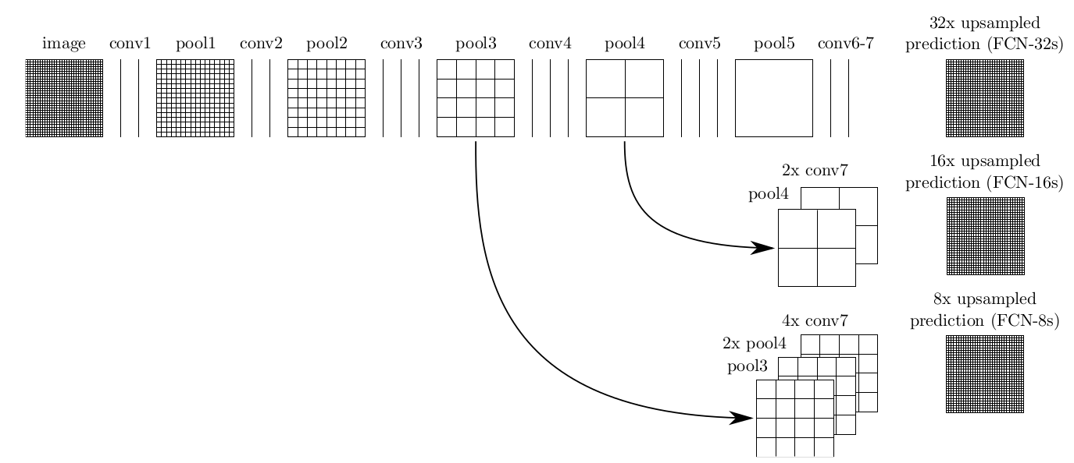
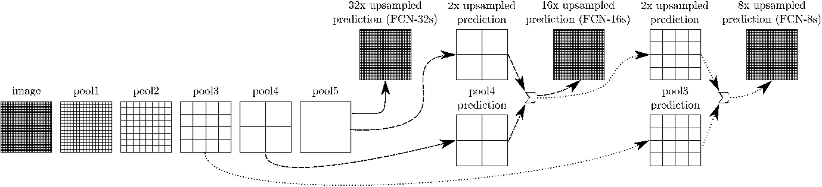
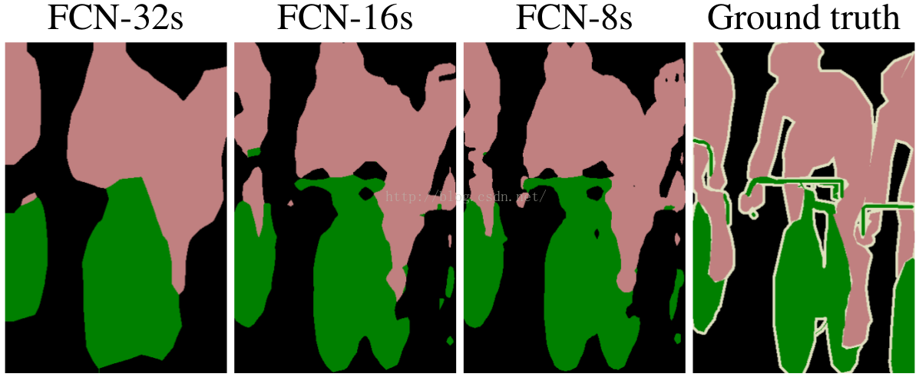
Fully Convolutional Networks (FCN)
Built from locally connected layers (i.e. convolution, pooling and upsampling and not dense layers)
Segmentation networks usually have 2 parts :
Downsampling path
Capture semantic/contextual information (i.e. used to extract and interpret the context (what is present in the image))
Upsampling path
Recover spatial information (i.e. used to enable precise localization (where it is present in the image))
Skip connections
a connection that bypasses at least one layer.
Used to recover fine-grained spatial information lost in the pooling or downsampling layers
used to transfer local information by concatenating or summing feature maps from the downsampling path with feature maps from the upsampling path. Merging features from various resolution levels helps combining context information with spatial information.
Notes:
Moving on we will be exploring techniques used in semantic segmentation
Segmentation task is different from classification task because it requires predicting a class for each pixel of the input image, instead of only 1 class for the whole input. Classification needs to understand what is in the input (namely, the context). However, in order to predict what is in the input for each pixel, segmentation needs to recover not only what is in the input, but also where.
again semantic segmendtation is different from instance segmentation in that we only label each pixel in the class it belongs to and not the instance of that class
One of the primary methods used in semantic segmentation is Fully Convolutional Networks
Owe their name to their architecture, which is built only from locally connected layers i.e. layers taking advantage of CNN’s parameter sharing
These networks usually have two sections:
a downsampling or encoder section which captures the context -- the what
An upsamplingor or decoder section which captures the where since the downsampling creates deep feature maps that lose the localization’
Another common inclusion in these FCNs are skip connections, but as we will see they are not required as is the case for the FCN-32s model.
a connection that bypasses at least one layer. Here, it is often used to transfer local information by concatenating or summing feature maps from the downsampling path with feature maps from the upsampling path. Merging features from various resolution levels helps combining context information with spatial information.
On the right here we can see three standard FCN variants that are used FCN-32, 16 & 8.
In the figures, convolutional layers are represented as vertical lines between pooling layers, which explicitely show the relative size of the feature maps
All three networks share the same downsampling path, in this case 7 convolutional layers and 5 maxpooling layers
The models differ in their upsampling methods (I.e. all layers after conv7 and the spatial precision of their output
Beginning with FCN-32s it umsamples directly from the conv7 layer using bilinear interpolation (i.e. a non-learned upsampling method)
https://towardsdatascience.com/understanding-semantic-segmentation-with-unet-6be4f42d4b47

Slide 19
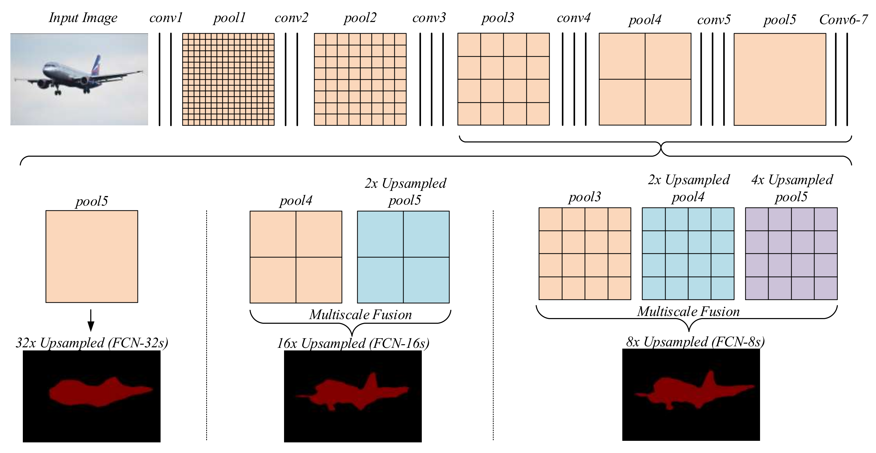
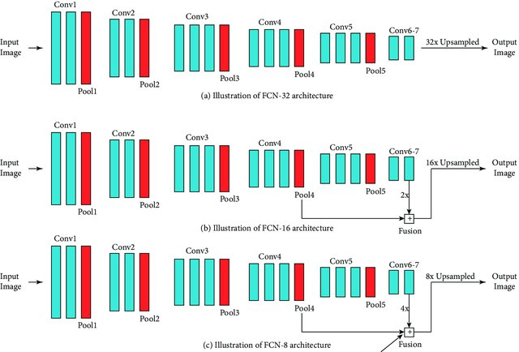
Fully Convolutional Networks (FCN)
The 3 FCN architectures:
Share the same downsampling path
Differ in their respective upsampling paths
They use different skip connection layers and strides for the last convolution
FCN-32
Produces the segmentation map directly from conv7 (using transposed convolution layer with stride 32 I.e.
FCN-16
Sums the 2x upsampled prediction from conv7 with pool4 ==> perform 16× upsampling to produce the segmentation map.
FCN-8
Sums the 2x upsampled conv7 with pool4 ==> upsamples them, then sums them with pool3 ==> upsamples final time to produce the segmentation map.
Notes:
http://deeplearning.net/tutorial/fcn_2D_segm.html
https://towardsdatascience.com/review-fcn-semantic-segmentation-eb8c9b50d2d1
Here is another visualization to better understand the different upsampling & skip connections used between these FCN variants.
Again, we see that the FCN-8 variant which combines layers that have different precision helps retrieving fine-grained spatial information, as well as coarse contextual information.
FCN-32 : Produces the segmentation map from conv7by using a transposed convolution layer with stride 32.
FCN-16 : Sums the 2x upsampled prediction from conv7 (using a transposed convolution with stride 2) with pool4 and then produces the segmentation map, by using a transposed convolution layer with stride 16 on top of that.
FCN-8 : Sums the 2x upsampled conv7 (with a stride 2 transposed convolution) with pool4, upsamples them with a stride 2 transposed convolution and sums them with pool3, and applies a transposed convolution layer with stride 8 on the resulting feature maps to obtain the segmentation map.

Slide 20
U-Net
U-Net Model
FCN variant (because only contains Convolutional layers and does not contain any Dense layer)
Developed by Olaf Ronneberger et al. for Bio Medical Image Segmentation
Symmetric shape (which is different from other FCN variants we have seen)
Extended to work with fewer training images and to yield more precise segmentations
U-NET vs. Standard FCNs
FCNs
Skip connections apply summation (i.e. tf.add downsampling feature maps to upsampling layers)
Use bilinear interpolation for upsampling so there is no learnable filter in the upsampling
U-Net
U-net is symmetric
Skip connections apply a concatenation operator instead of a sum (i.e. tf.concat downsampling feature maps to upsampling layers)
Uses transposed convolutions (aka deconvultion or fractionally strided convolution) which are learnable weight filters instead of fixed interpolation techniques (I.e. bilinear and other techniques we discussed in the image processing lecture)
Notes:
https://towardsdatascience.com/understanding-semantic-segmentation-with-unet-6be4f42d4b47
We have chosen to discuss the UNET model as a final model because it was the best performing model in this kaggle competition and is state of the art. Furthermore, it works well with fewer training images and yields more precise segmentations.
In addition, UNET is
An improved and better performing variant of the FCN is the U-NET model
Developed by Olaf Ronneberger et al. for Bio Medical Image Segmentation
Owes its name to the symmetric U-shape created between the downsampling and upsampling paths – each with equal number of convolution blocks
Comparing U-NET to the previous FCNs we looked at, here are the differences:
Previous FCN variants used summation in their skipped connection between downsampling and upsampling layers while U-Net uses concatenation similar to the densenet previously discussed
Again Unet is symmetric while previous variants were not
Most importantly, the umsampling path in U-Net is learnable and uses transposed convolution rather than interpolation techniques used by previous FCN variants
We will discuss how the transposed convolutions in the upsampling section work in the next slide
These skip connections intend to provide local information to the global information while upsampling.
Because of its symmetry, the network has a large number of feature maps in the upsampling path, which allows to transfer information.
By comparison, the basic FCN architecture only had number of classes feature maps in its upsampling path.

Slide 21

Transposed Convolution
Transposed convolution is the opposite process of a normal convolution
Regular Convolution = many-to-one relationship (i.e. high resolution => low resolution)
Transposed Convolution = one-to-many relationship (i.e. low resolution => high resolution)
No padding, no strides, transposed
No padding, strides, transposed
Blue maps are inputs, and cyan maps are outputs.
Notes:
Previous upsampling techniques we discussed used such as bilinear interpolation or nearest neghbor interpolation involved some interpolation method which we need to chose when deciding a network architecture. It is like a manual feature engineering and there is nothing that the network can learn about.
If we want our network to learn how to up-sample optimally, we can use the transposed convolution.
It does not use a predefined interpolation method
It has learnable parameters
Transposed convolutions AKA Fractionally-strided convolution OR Deconvolution is a one to many relationship that goes from low resolution to high resolution
In other words it is the opposite process of a normal convolution
https://medium.com/activating-robotic-minds/up-sampling-with-transposed-convolution-9ae4f2df52d0

Slide 22
U-Net Architecture
Advantages
General information
Combines the location information from downsampling path with contextual information from upsampling path to obtain a general information for segmentation
No dense layers
so images of different sizes can be used as input (since the only parameters to learn on convolution layers are the kernel, and the size of the kernel is independent from input image’ size).
1. Downsampling/Contracting
Four block each composed of:
3x3 Convolution Layer + activation function (with batch normalization)
3x3 Convolution Layer + activation function (with batch normalization)
2x2 Max Pooling
2. BottleNeck
Simply 2 convolutional layers (with batch normalization), with dropout.
3. Upsampling/Expanding
Four block each composed of:
Deconvolution layer with stride 2
Concatenation with the corresponding cropped feature map from the contracting path
3x3 Convolution layer + activation function (with batch normalization)
3x3 Convolution layer + activation function (with batch normalization)
Notes:
Finally here is an in-depth look at what the unet architecture looks like
The architecture contains two paths:
First path is the contraction path (also called as the encoder) which is used to capture the context in the image. The encoder is just a traditional stack of convolutional and max pooling layers.
The second path is the symmetric expanding path (also called as the decoder) which is used to enable precise localization using transposed convolutions.
The colored arrows describe the transformation being applied
In the Encoder, the size of the image gradually reduces while the depth gradually increases.
This basically means the network learns the “WHAT” information in the image, however it has lost the “WHERE” information
The right hand side is the expansion path (Decoder), the size of the image gradually increases and the depth gradually decreases
We apply transposed convolutions along with regular convolutions
The Decoder recovers the “WHERE” information (precise localization) by gradually applying up-sampling
To get better precise locations, at every step of the decoder we use skip connections by concatenating the output of the transposed convolution layers with the feature maps from the Encoder at the same level (the grey arrows)

Slide 23
Conclusion

Slide 24
Conclusion
Image Classification:
Results from Transfer learning with 'DenseNet169' resulted in an 0.89 F2-score, 0.88 Recall, and 0.91 Precision
In the future, it would be interesting to implement different networks (e.g., deeper networks) to train the classifier
Furthermore, it would be interesting to compare the transfer learning model to a CNN that was specifically trained for the ship classification task
Semantic Segmentation:
Semantic segmentation is used to classify the object class within image at a pixel level.
Segmentation consists of two phases: fully convolutional layer and upsampling layer. The first phase learns local presentations, and the second phase sums them up together
We want to use a special type of segmentation called U-net whose downsampling and upsampling have symmetric counterparts

